Slide 1
Sentiment Analysis
over
Twitter Network
Presented By :
Jitendra Patel

Slide 2

Introduction
TWITTER
Social Networking microblogging service
Enable users to share thoughts through tweets
SENTIMENT ANALYSIS
Identify the orientation of the opinion in piece of text to determine if a sentence or document is positive, negative or neutral.

Slide 3
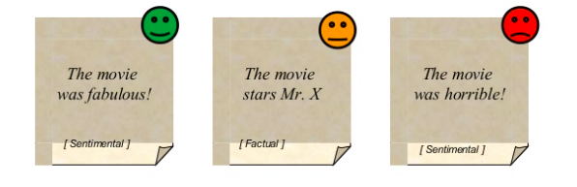
Motivation
To classify the polarity of tweets to determine attitude of people towards a movie.
To predict the success of movie using twitter data

Slide 4




Challenges
Highly unstructured data
Out of vocabulary words
Lexical variation
Excessive use of acronym
Lack of context- only 140 characters

Slide 5
Approach
Tweet Fetching
Tokenizing
Pre-processing
Sentiment Analysis
Prediction

Slide 6
Dataset
Data gathered using twitter streaming API
Hbc: Java HTTP client for consuming live tweets
Data collected during critical period
Data gathered for two movies
FAN released on April 15, 2016
THE JUNGLE BOOK released on April 15, 2016
Total tweets collected : 100,160 of size 560 MB

Slide 7


Tokenization
Tokenization creates a "bag of words" that are contained in a document. This allows us to do further filtering on a document.
All words in a tweet are broken into tokens.
For example:-
‘inside’ ‘out’ ‘is’ ‘an’ ‘amazing’ ‘movie’ are individual tokens

Slide 8
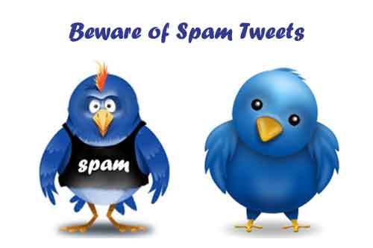
Why Data Pre-Processing ?
Lot of noisy spam, irrelevant
tweets in our dataset
Convert tweets into a data format for
sentiment analysis

Slide 9
Data Pre-Processing Methodologies
Stop words
Stemming
Parts of Speech tags
Length of words
Sarcasm

Slide 10
Stop words: After we have created bag of words we are ready to filter the documents. We want to filter certain words out of a document that don't really have any meaning to the document itself (such as articles a, an, the, etc.)
Stemming: The next preprocessing step is stemming. It is a method for collapsing distinct word Forms. The main purpose of stemming is to reduce different grammatical forms / word forms of word like its noun, adjective, verb, adverb etc. to its root form.
Length of words: We would want to filter out any remaining words that are less than four characters or more than 10 characters
Transform: After we filtered the bag of words by stop-words and length, we want to transform all of our words to lowercase since the same word would be counted differently if it was in uppercase vs. lowercase.

Slide 11
Sentiment Analysis
APPROACH 1 : Using RapidMiner
The sentiment score will be aggregated based on the COUNTS of the positive and negative words matched with harvard dictionary (consists of around 7000+ words).
Example: Good = Positive Count 1 Bad = Negative count 1

Slide 12
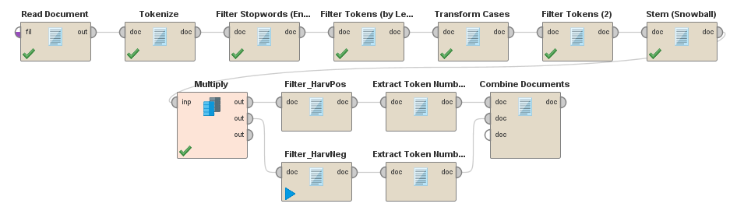
Approach 1: Processing

Slide 13
Output: Approach 1
Movie 1 : Fan
Positive Counts = 165243
Negative Counts = 72894
Total = 238137
Positivity score = 69.38 %
Movie 2 : The Jungle Book
Positive Counts = 15649
Negative Counts = 8024
Total = 23673
Positivity score = 66.10%

Slide 14
Sentiment Analysis contd..
APPROACH-2 : Using Hadoop Mapper/Reducer and Custom Counters
Mapper :
Tokenization of tweets
Dictionary : Bing Liu’s Opinion Lexicon (6786 words : 2005 positive and 4781 negative)
Stop words
Count increment of positive, negative and neutral words

Slide 15
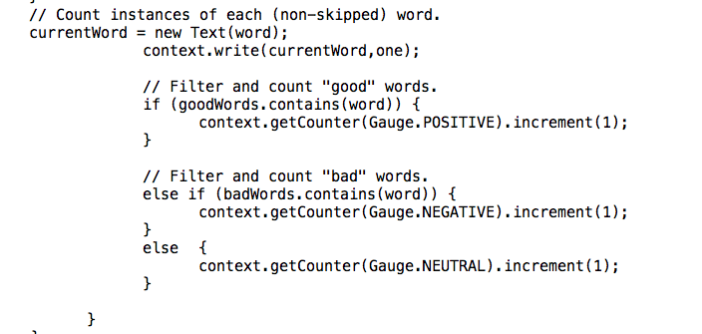
APPROACH-2 contd..
Mapper code snippet

Slide 16
APPROACH-2 contd..
Reducer : Aggregation of words
Hadoop Job :
Read the custom counters
Sentiment score/Positivity score calculation
Sentiment Score = (Positive - Negative)/(Positive + Negative)
Positivity Score = Positive count / (Positive + Negative)

Slide 17
Output: Approach- 2
Movie 1 : Fan
Good : 102930.0 Bad : 18089.0 Neutral : 2048386.0
Sentiment score = (102930.0 - 18089.0) / (102930.0 + 18089.0)
Sentiment score = 0.7010552
Positivity score = 102930.0 / (102930.0+18089.0)
Positivity score = 85%
Movie 2 : The Jungle Book
Good : 7721.0 Bad : 1656.0 Neutral : 202279.0
Sentiment score = (7721.0 - 1656.0) / (7721.0 + 1656.0)
Sentiment score = 0.64679533
Positivity score = 7721.0 / (7721.0+1656.0)
Positivity score = 82%

Slide 18
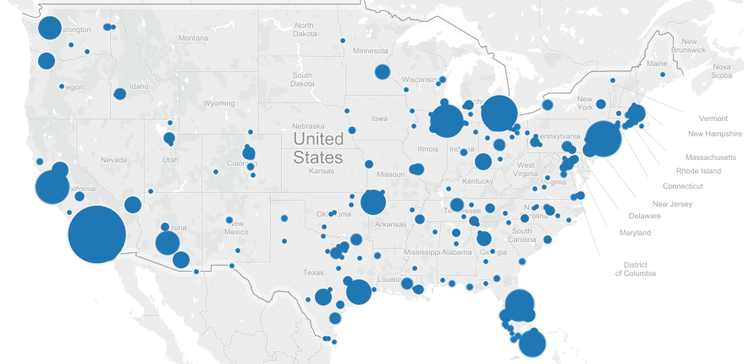
Jungle Book: US

Slide 19
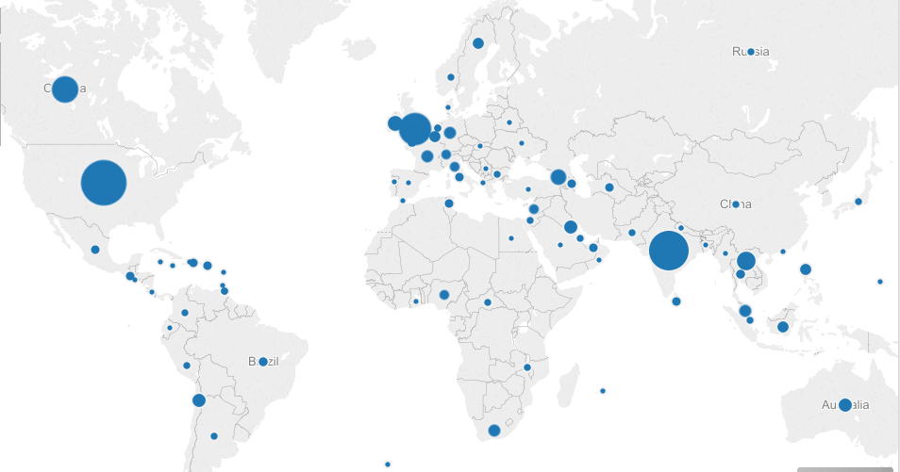
Jungle Book: World

Slide 20
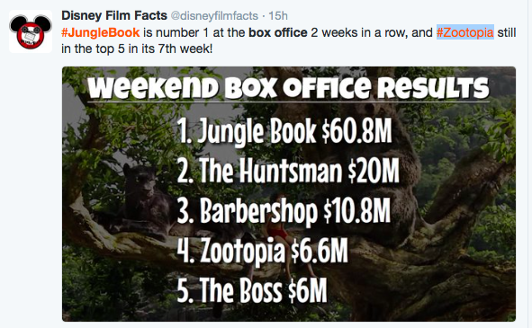
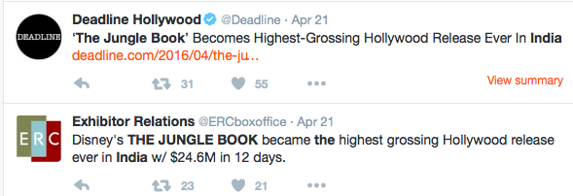

The Jungle Book: Total Box Office Collection

Slide 21
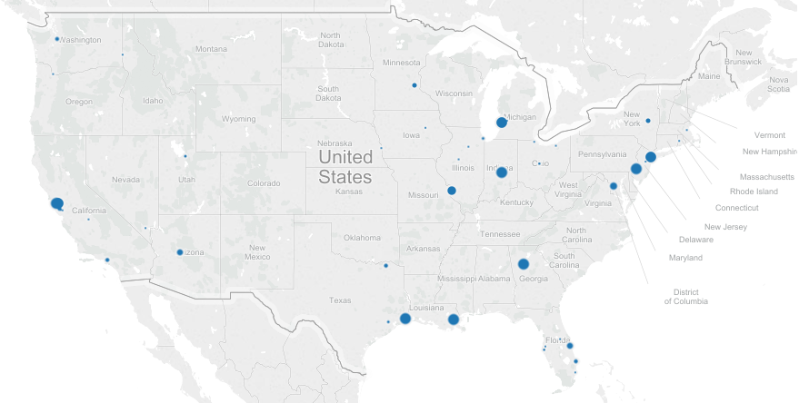
Fan: US

Slide 22
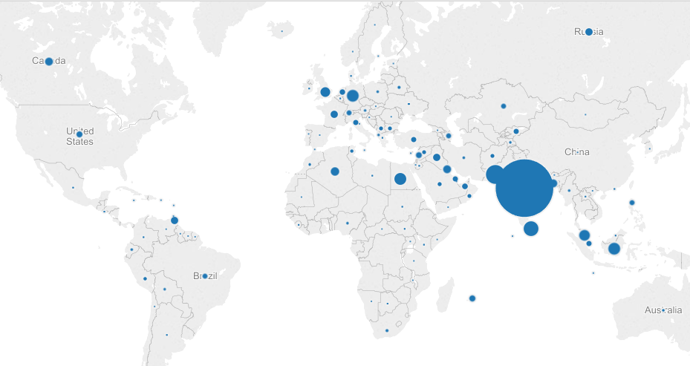
Fan : World

Slide 23
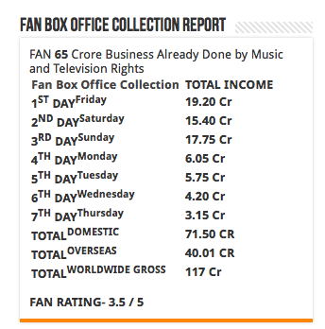
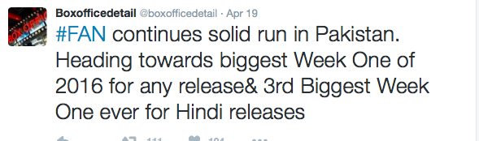

Fan: Total Box Office Collection

Slide 24
Future Scope
Train a classifier by implementing different machine learning algorithms that can automatically predict negative, positive and neutral tweets
Consider emoticons dictionary that can help to better predict sentiments of tweets
Look for better ways to handle irony/sarcasm: NLP toolkit
Study correlation between sentiments and box office collection

Slide 25


